Slide 1
Real Time Railways Twitter Complaint System
Mid-Sem Project Presentation (BCS-40)
Computer Science and Engineering Department
Madan Mohan Malaviya University of Technology Gorakhpur
Group Id : 42
Group Members:
Gaurav Pandey (2018021052)
Kumari Vani (2019022010)
Meera Gupta (2019022011)
Guided By:
Dr. P. K. Singh
Evaluated By:
Prof. A. K. Sharma

Slide 2
Content -
Introduction
Project Purpose
Scope of Project
Description of Project
Requirement Analysis
Software Requirement Specifications
Feasibility study

Slide 3
Introduction-
The project reduces the work complexity of scanning through thousands of useless data to find particular information but from here we can directly find the relevant tweets that needs attention.
We just have to filter the tweets on the basis of name of the particular authority and hence it reduces the operational time.
For filtering the tweets on the basis of level of seriousness or urgency, we will using a Machine Learning Model ( Naïve Bayes ).

Slide 4
Project Purpose-
We try to implement and improve the current working model to a better machine learning model in future development.
Increase fault-tolerance.
Increased accuracy and reliability.
Increased operational efficiency.
Increased Data security as manual labour is not involved so no unwanted user can read all such information.

Slide 5
Scope of Project-
This project has a large scope as it has the following features which help in making it easy to use, understand and modify it:
Automation of Feedback and complaint addressing.
No need to do Paper Work.
To save the environment by using paper free work.
To increase the accuracy and efficiency of the complaint addressing procedure.
Management of Passenger Data.

Slide 6
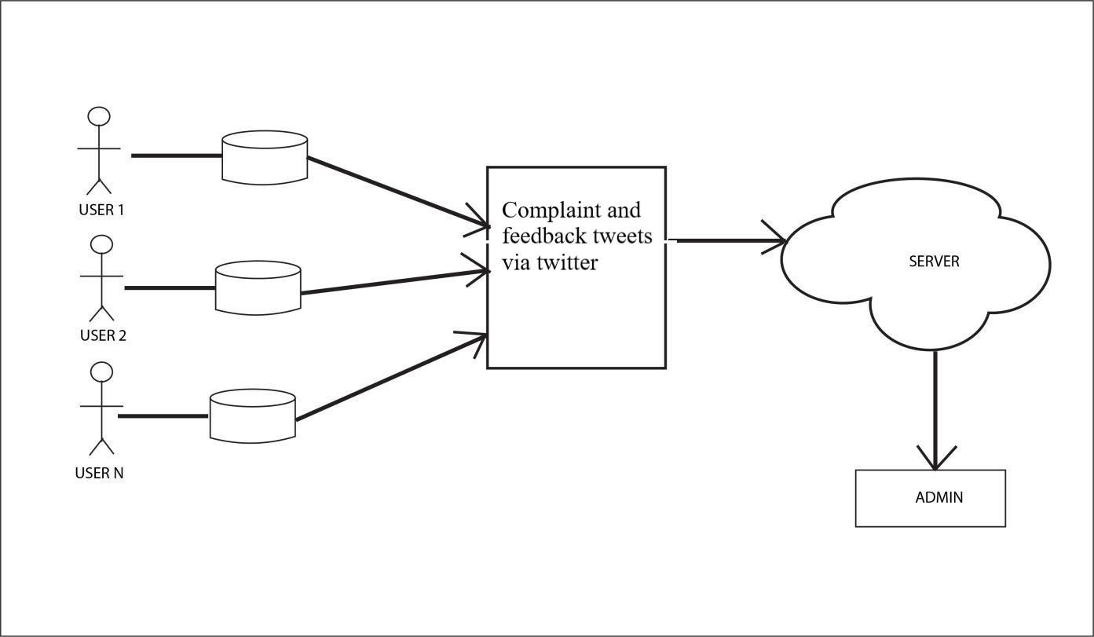
Description of project-

Slide 7
Requirement Analysis-
Information Gathering-
For our project, we collect all the necessary information that is tweets. We also collect basic information about our user, PNR number of the train, tweet id.
2. Functional Requirements-
User: The user should have a twitter account so that the user can tweet with @RailMinIndia if he/she have complain.
Dataset: A dataset is a collection of data. The dataset comprise data for one or more member, corresponding to the number of rows.

Slide 8
App and Web Module: This Module Contain Admin Module, login module, reply module.
Admin Module- The person who reply for the tweets.
Login Module- The admin can only login into the app with particular login Id and password.
Reply Module- To reply the tweets in real time.

Slide 9
Software Requirements-
Software Requirement Specification-
MySQL essentials (server), MySQL Workbench
Jupyter Notebook
Apache spark
Visual studio Code for Web Development
Android studio
Microsoft PowerPoint
Windows 10 or Linux Operating System

Slide 10
Hardware Requirements-
2.7 GHz x86 processor
4 GB of system memory (RAM)
512 GB of Hard-Drive space
Keyboard/Mouse for data input
Monitor to display output

Slide 11
Feasibility study-
Operational Feasibility-
Our proposed system is capable identifying the emergency tweets more quickly and is more flexible and efficient than the existing systems.
2. Technical Feasibility-
The system as mentioned is developed using the latest technologies which include Kafka ,Spark ,Zookeeper ,Xampp ,Cloud, Flutter, Big data.

Slide 12
3. Economic Feasibility-
Our proposed system is alone sufficient to save time and money and thus it is economically Feasible.
4. Behavioral Feasibility-
This project is evaluated to be behaviorally feasible as it is very user-friendly and hardly needs any extra efforts to educate user for its facility and functioning.

Slide 13
